Slide 1
IBM University Engagement Project Submission
“Exploring the Power of Agentic AI with IBM Granite and LangFlow”

Slide 2
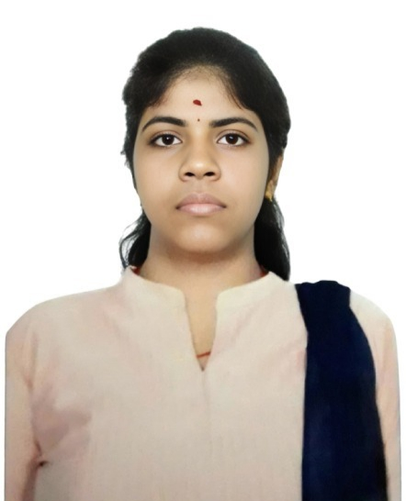
Project Tile – [Smart Research Intelligent System]
Domain of Project – [Education & Research]
Student Name | Recent Passport Photo | Email ID | Mobile number [WhatsApp]
C PUSHPALATHA |  | AICTE ID: iyappan041987@gmail.com EMAIL ID(as per skills build): balasubramaniyar2004@gmail.com | 9940163279

Slide 3
Problem Statement -
Problem Statement : Research Agent
The Challenge
Research activities often require extensive time and effort in searching academic papers, reviewing literature, extracting key findings, managing references, and organizing information from multiple sources. Researchers, students, and professionals frequently struggle to identify relevant studies, understand complex research topics, and generate structured research reports efficiently.The growing volume of scientific publications makes it difficult to stay updated with the latest developments. Manual literature review and information extraction can be repetitive, time-consuming, and prone to missing critical insights.
The Objective
Build an AI-powered Research Agent that assists researchers, students, and professionals throughout the research lifecycle. The solution should:
Literature Search & Retrieval
Retrieve relevant academic papers, articles, and research content based on user queries.
Research Summarization
Generate concise summaries of research papers, articles, and technical documents.
Knowledge Extraction
Extract key findings, methodologies, conclusions, and important insights from research content.
Research Report Generation
Automatically generate structured research reports and literature reviews.
Multi-Agent System
Literature Search Agent – Retrieves relevant research information
Research Summarization Agent – Summarizes academic papers and articles
Knowledge Extraction Agent – Extracts key findings and insights
Report Generation Agent – Generates structured research reports

Slide 4
Technology Used
Tech Stack (Mandatory)
Use any one of the following approaches:
LangFlow + IBM watsonx.ai + Granite Models
IBM Cloud Agentic Lab with IBM Granite Models
Replicate with LangChain + RAG + IBM Granite Models
I used LangFlow + IBM watsonx.ai + Granite Models

Slide 5
Proposed Solution -
Proposed Solution: Research Agent
The proposed solution is a multi-functional AI-powered Research Agent developed using LangFlow, IBM watsonx.ai, and IBM Granite Models to streamline academic and scientific research activities. The system helps users search, analyze, summarize, and organize research information efficiently.
At its core, the solution utilizes IBM Granite Models to understand research queries, retrieve relevant information, and generate meaningful insights. The system assists users by automating literature review, knowledge extraction, report generation, and research organization tasks.
The system consists of four key agents:
Literature Search Agent
Retrieves relevant research papers, articles, and information based on user queries.
Research Summarization Agent
Generates concise summaries of academic papers and technical documents.
Knowledge Extraction Agent
Extracts key findings, methodologies, conclusions, and important insights from research content.
Report Generation Agent
Creates structured research reports and literature reviews from gathered information.
The solution provides a simple conversational interface where users can submit research questions and receive comprehensive responses, summaries, and research insights.
LangFlow is used to design and orchestrate the workflow, while IBM watsonx.ai provides model deployment and execution capabilities.
IBM Granite Models power the reasoning, summarization, and knowledge-generation functionalities.
Overall, the solution acts as an intelligent digital research assistant that enhances productivity, reduces manual effort, and accelerates research activities.

Slide 6
Langflow component Used -
Chat Input
Interface where users enter research questions, topics, or information requests.
2) IBM watsonx.ai Component
Processes user queries using IBM Granite Models and generates research-oriented responses.
3) Name of IBM Granite Model
Granite-8B-Code-Instruct Provides reasoning, text generation, summarization, and research assistance capabilities.
4) Chat Output
Displays generated summaries, insights, research findings, and reports.
5) System Message Component
Defines the behavior and objectives of the Research Agent.
Connection Workflow
Connects user input, IBM Granite processing, and output generation within LangFlow.

Slide 7
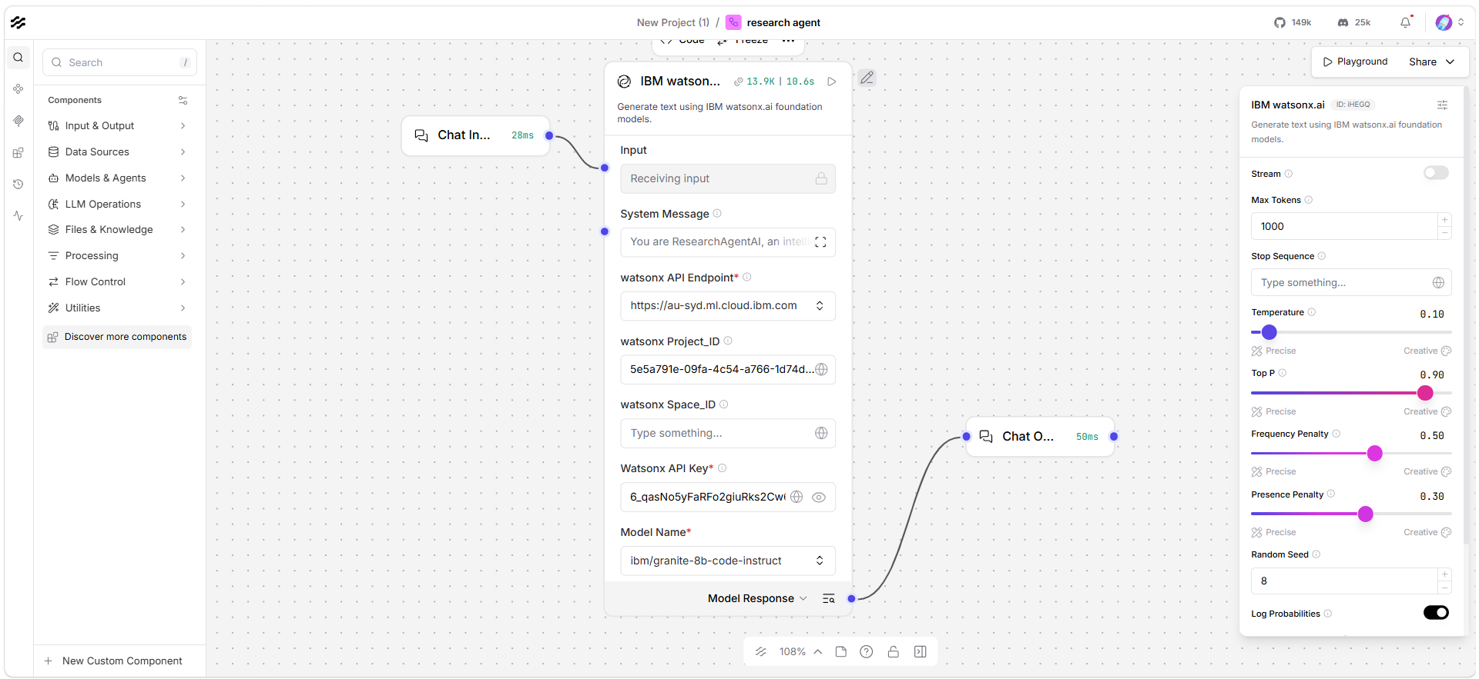
Langflow workflow -

Slide 8
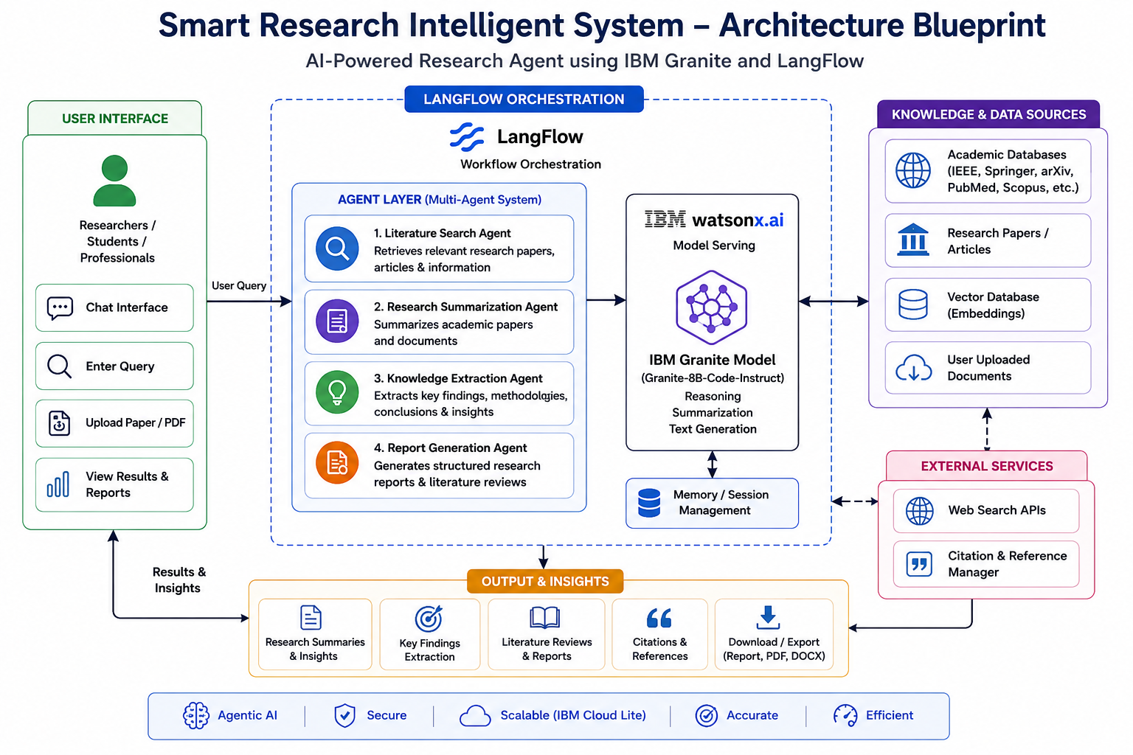
Architecture blueprint

Slide 9

Role of Agentic AI in the solution
Role of Agentic AI in Research Agent
Agentic AI enables the Research Agent to function as an intelligent and autonomous research assistant rather than a traditional chatbot.
Using IBM watsonx.ai and IBM Granite Models, the system understands research objectives, analyzes user queries, and generates meaningful research insights.
Each agent performs specialized tasks such as literature search, summarization, knowledge extraction, and report generation while working together to provide comprehensive research assistance.
Agentic AI allows the system to:
Understand complex research questions
Analyze large volumes of information
Generate concise summaries
Extract important findings
Organize research knowledge
Produce structured reports
Overall, Agentic AI makes the solution proactive, intelligent, and goal-oriented, acting as a virtual research assistant for academic and industrial research.

Slide 10
Technology Used
LangFlow Platform
For designing and orchestrating AI agent workflows visually.
IBM Granite Model
For natural language understanding, reasoning, summarization, and report generation.
IBM watsonx.ai
For model deployment, execution, and AI governance.
IBM Cloud Lite Services
Provides secure, scalable cloud infrastructure for hosting and deployment.
Agentic AI
Enables autonomous task execution and intelligent decision-making.
Natural Language Processing (NLP)
Allows understanding and processing of research-related queries.

Slide 11
Novelty and Uniqueness
The proposed Research Agent stands out by combining Agentic AI, IBM Granite Models, and workflow automation into a single intelligent research assistant.
Multi-Agent Intelligence
Specialized agents collaborate to perform research-related tasks efficiently.
Automated Research Assistance
Reduces manual effort involved in literature review and information gathering.
Intelligent Summarization
Generates concise and meaningful summaries from complex research content.
Knowledge Extraction
Automatically identifies key findings, methodologies, and conclusions.
Report Generation
Creates structured research reports and documentation.
IBM Granite-Powered Reasoning
Leverages advanced IBM AI capabilities for accurate and context-aware responses.
Scalable and Enterprise-Ready
Built using IBM watsonx.ai and IBM Cloud technologies.
This transforms traditional research workflows into a faster, smarter, and more efficient process.

Slide 12
Git Hub Link
· Please create public github repository (Enable Add README button while creating repository) with format –
Please test and Paste the working Github URL – https://github.com/cpushpalatha9/Smart-Research-Intelligent-System.git
Make sure you have Uploaded following three files into your github repository 1) app.json file , 2) yourproblemstatement.pdf file 3) your projectpresntation.pptx file 4)any other files
·
·
·

Slide 13
Future Scope
1. Integration with Research Databases
Connect with IEEE, Springer, arXiv, PubMed, and Google Scholar for real-time research retrieval.
2. Citation Management
Automatically generate APA, MLA, IEEE, and Chicago citations.
3. Research Paper Upload Analysis
Allow users to upload PDFs and receive summaries, insights, and key findings.
4. Multi-Agent Collaboration
Introduce specialized agents for literature review, citation generation, and hypothesis development.
This format closely matches the IBM submission template structure and wording style.
·
·
·

Slide 14


